Slide 1
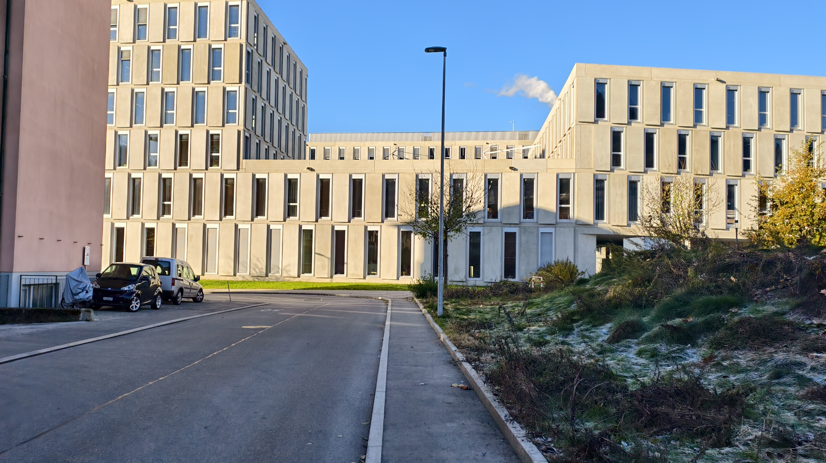
Computer vision and deep learning project
Tommaso Sommaruga
Miro Rava

Slide 2
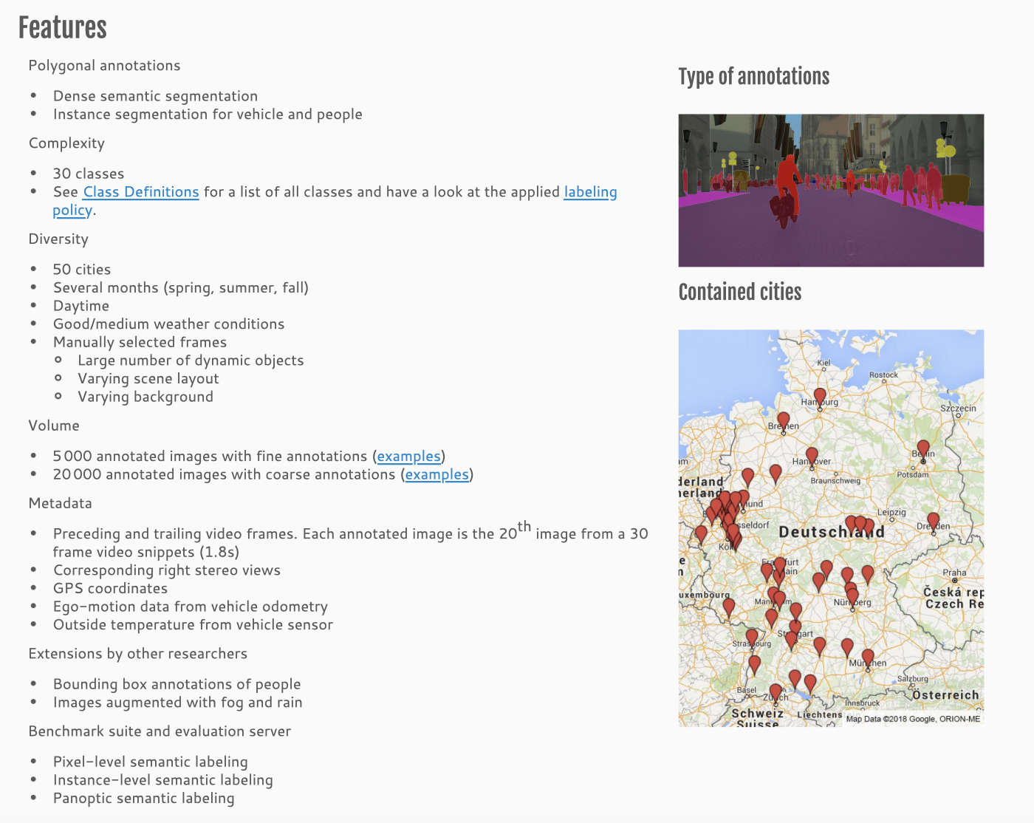
Overview
https://www.cityscapes-dataset.com/dataset-overview/

Slide 3


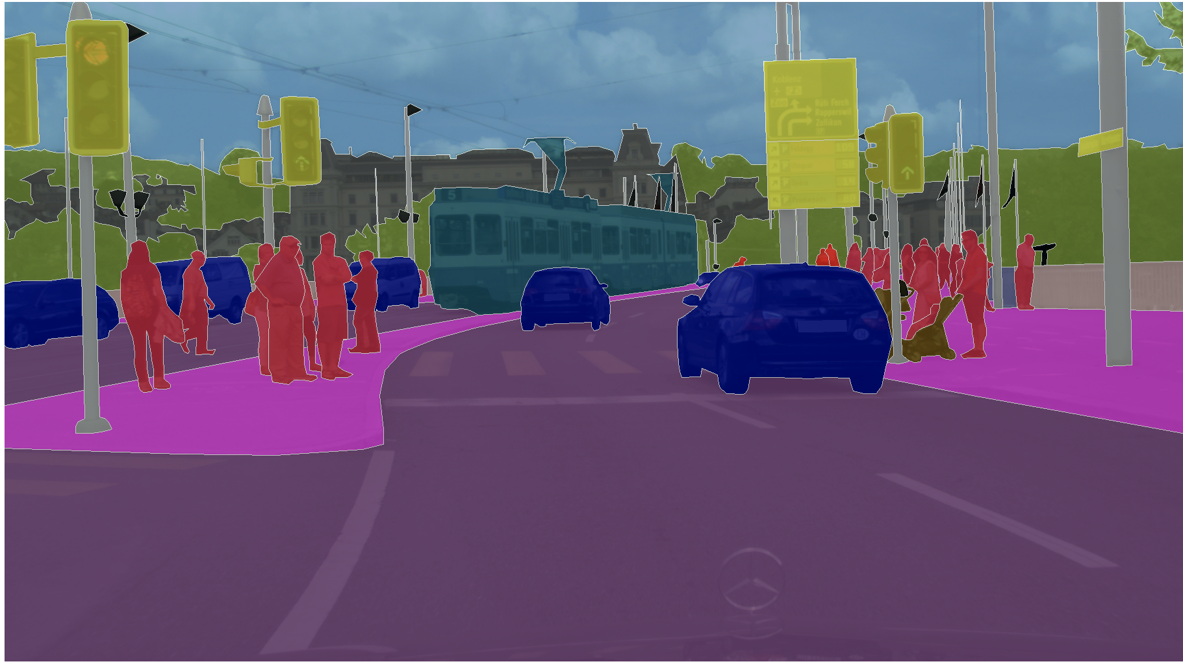

Slide 4
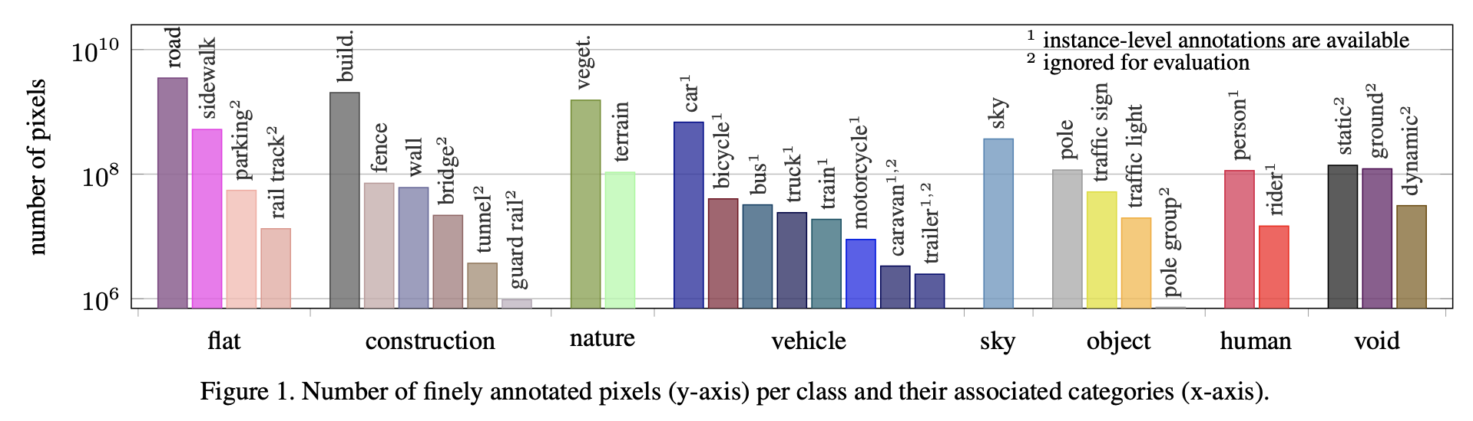
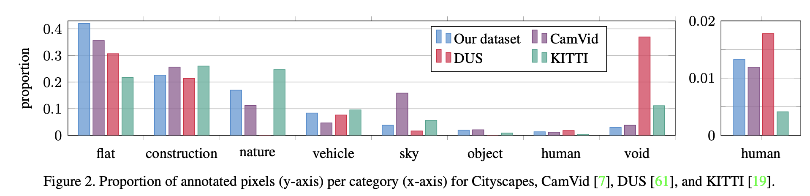
Proportion of objects and pixels

Slide 5
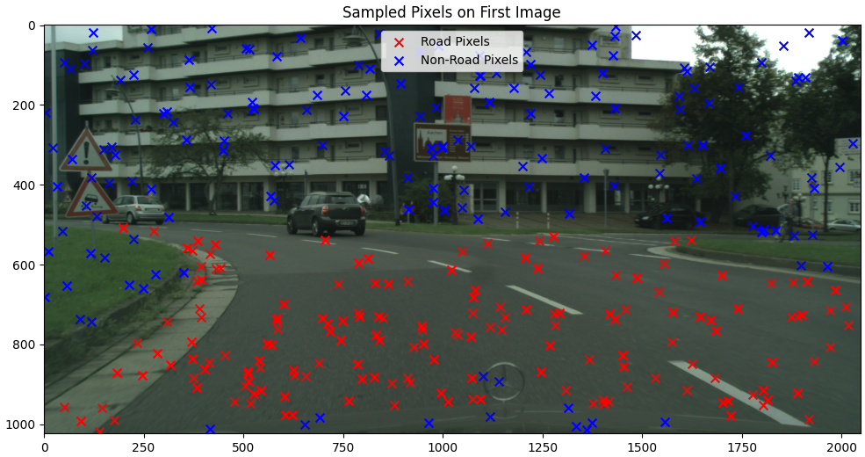
Single Pixel Classifier
Sampling Method

